Slide 1

Real-Time Anomaly Detection in ICS/OT using Behavioral EDR
PRESENTED BY
Safna S
DOMAIN
Cyber Security
GUIDED BY
Rahul R, Assistant Profess
A Multi-Layered Statistical Defense for Critical Infrastructure

Slide 2




The Critical Need for ICS/OT-Specific Security
Continuous Data Streams
Physical Consequences
■ ICS data consists of continuous sensor measurements (flow, pressure, level), not discrete files or network packets.
■ A breach in OT can lead to physical damage, environmental hazards, and direct threats to public safety.
Subtle Attack Vectors
The Signature Gap
■ Attacks often manifest as subtle sensor drifts that stay within "acceptable" ranges but violate process logic.
■ Conventional tools cannot detect zero-day attacks that have no pre-existing signatures or documented patterns.

Slide 3





Introducing Behavioral EDR for ICS
Behavioral Analysis
■ Learns the unique statistical fingerprint of normal plant operations to establish a trustworthy reference.
Endpoint Detection
■ Monitors process-level variables directly at the sensor/actuator interface for maximum visibility.
Multi-Layered Pipeline
■ Integrates 12 specialized mathematical formulas—from **EWMA** to **Shannon Entropy**—for comprehensive coverage.
Frozen Baseline
■ A key innovation that locks model parameters after warmup to prevent adversarial drift and model poisoning.

Slide 4








The 12-Formula Detection Engine
1. State Vector Extraction
2. Sliding Window
■
Consolidates 14 sensors into a real-time snapshot.
■
Maintains the 50 most recent states for context.
X_t = [x₁(t), x₂(t), ..., x₁₄(t)]ᵀ
W_t = {X_{t-n+1}, ..., X_t}
3. EWMA Mean & Variance
4. Mahalanobis Distance
■
Computes smoothed baselines resistant to noise.
■
Measures multivariate deviation with correlations.
μ_t = α·X_t + (1-α)·μ_{t-1}
D_M(t) = √((X_t-μ)ᵀ·Σ⁻¹·(X_t-μ))
5. Probability & Reconstruction
6. Entropy & Timing
■
Maps distance to likelihood and raw error metrics.
■
Detects disorder and communication irregularities.
P(X_t) = exp(-0.5·(D_M/10)²)
H = -Σ P(sᵢ)·log(P(sᵢ))
7. Risk & Unknown Scores
8. Persistence Check
■
Aggregates signals to identify zero-day threats.
■
Filters transient noise for high-confidence alerts.
U_t = w₁·(1-P) + w₂·E_t + w₃·T + w₄·H
Persistent = (Σ last_5_scores) > γ

Slide 5




The "Frozen Baseline" Strategy
Warmup Phase
Parameter Lock
Drift Prevention
■ The system learns the plant's normal behavior during the first 200 samples. ■ Establishes initial statistical parameters in a clean environment.
■ At sample 200, the mean (μ), variance (σ²), and inverse covariance (Σ⁻¹) are permanently frozen. ■ Reference point is secured.
■ Attacks cannot "poison" the model by gradually shifting the reference point over time. ■ Ensures long-term reliability of detection.

Slide 6




Core Metric: Mahalanobis Distance (D_M)
Beyond Euclidean Distance
■ Accounts for the covariance structure between sensors, detecting coordinated anomalies that single-sensor monitoring misses.
NORMAL BASELINE (AVG)
4.21
ATTACK DEVIATION (AVG)
Optimal Threshold Strategy
177.41
■ A threshold of **D_M > 5** provides the optimal balance between high recall and operational continuity (97.6% Precision).
42× Separation
Ratio between normal and attack data points
Clear Distinction
■ The massive statistical gap ensures that genuine cyber attacks are clearly distinguishable from normal operational noise.

Slide 7


Detecting the Unknown: The U
Score
_{t}
Identifying Zero-Day Attacks
■ Flags behavior that has never been seen during the training phase, enabling detection of novel threats without signatures.
Unknown Behavior Score
U
= w
(1-P) + w
E
+
Proactive Defense
_{t}
₁
₂
_{t}
w
₃
T
_{s}
+ w
₄
H
■ Does not require prior knowledge of an attack's characteristics, methods, or specific industrial protocol vulnerabilities.
A weighted aggregation of inverse probability, reconstruction error, timing deviation, and Shannon entropy.
Actionable Intelligence
■
High U
_{t}
scores trigger immediate forensic investigation, providing
operators with a clear signal of abnormal process evolution.

Slide 8




Validation: The SWaT Testbed
Source & Infrastructure
■ Developed by iTrust, SUTD (Singapore). A fully operational water treatment facility with 6 interconnected sub-processes.
1.4M
TOTAL RECORDS
51
Realistic Attack Data
■ Dataset covers 11 days of operation, including coordinated red-team attacks like valve manipulation and sensor spoofing.
SENSORS & ACTUATORS
41
ATTACK SCENARIOS
Ground Truth Validation
■ Rigorous validation against 41 different cyber-physical attack scenarios to ensure comprehensive detection coverage.

Slide 9

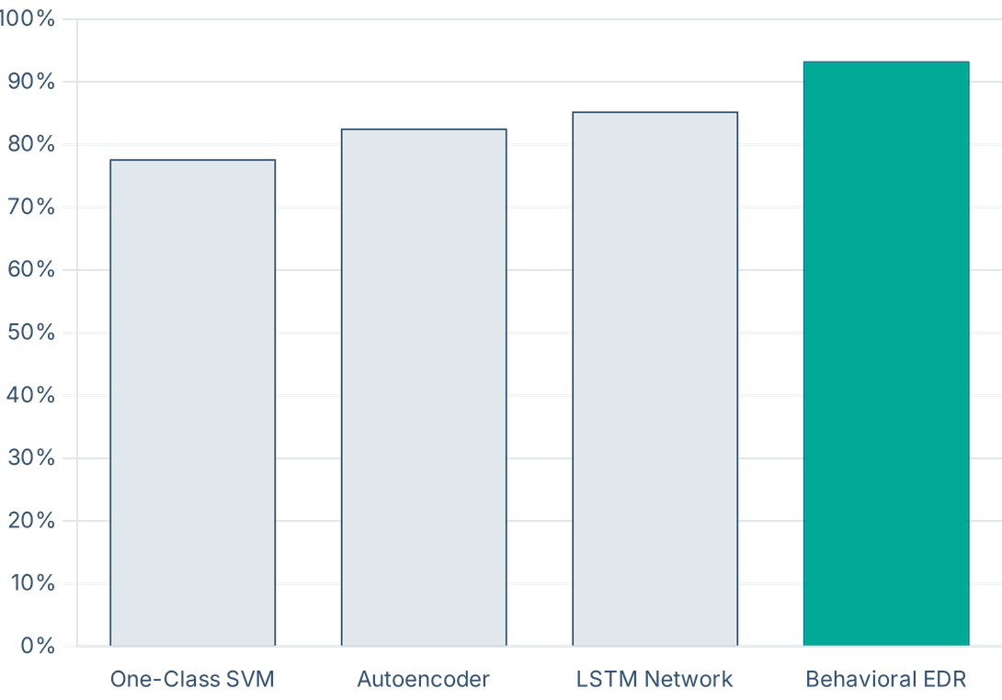
Performance Benchmarking: Superior Results
F1-Score Comparison (SWaT Dataset)
Precision
97.6%
■ Extremely low false alarm rate; critical for maintaining trust in industrial operations.
F1-Score
93.3%
■ Best-in-class balanced performance, outperforming deep learning methods.
Accuracy
89.4%
■ Reliable detection across diverse and sophisticated cyber-physical attack vectors.

Slide 10






The Behavioral EDR Dashboard
Real-Time Monitoring
Visual Intelligence
SOC Alert Table
■ Live Metric Tracking
■ System Health Gauge
■ Detailed Attribution
Continuous visualization of
Instant visual status of the monitored
Filterable alert logs with specific sensor
Mahalanobis Distance (D_M), Unknown
industrial process with a rolling 100-
identification and severity-based drill-
Score (Ut), and Shannon Entropy.
packet threat level.
down panels.
Interpretability
Event Timeline
Simulation Control
■ Transparent Evidence
■ Attack Narrative
■ Interactive Testing
Moves beyond "black-box" AI—
Chronological history of detected
Play/pause/reset controls with speed
operators see the exact mathematical
anomalies, system responses, and
adjustment to observe model response
formulas behind every detection.
forensic audit trails.
to diverse scenarios.

Slide 11




Conclusion & Future Roadmap
Project Summary
Future Scope
■ Successfully delivered a deployable, real-time, and highly interpretable EDR system specifically tailored for the unique constraints of ICS/OT environments.
■ **Multi-Plant Monitoring**: Centralized visibility across global industrial fleets.
■ **Deep Learning Ensemble**: Combining statistical rigor with neural pattern recognition.
■ **Automated Response**: Direct integration with PLC safety routines for instant mitigation.
Key Accomplishment
■ **Protocol Analysis**: Adding support for Modbus and DNP3 packet-level inspection.
■ Outperformed standard ML models with a **93.3% F1-score** while maintaining full transparency through a 12-formula statistical pipeline.

Slide 12


Thank You

